Slide 1
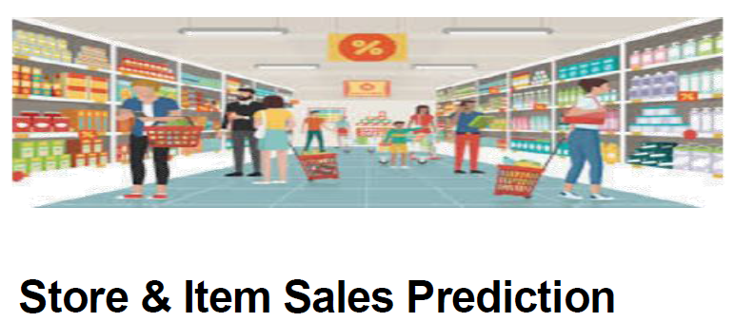

STORE ITEM SALES PREDICTION
TIME SERIES
(ARIMA MODEL)
PRIYA DAVIS

Slide 2
FRAMEWORK:
DATASET DESCRIPTION & OBJECTIVE
EXPLORATARY DATA ANALYSIS
STATIONARITY CHECK
DATA TRANSFORMATION
TRAIN TEST SPLIT & BUILDING MODELS
CONCLUSION

Slide 3
DATASET DESCRIPTION & OBJECTIVE
The objective of this Project is to predict 03 months of item-level sales data at different store locations
Data fields
· date - Date of the sale data. There are no holiday effects or store closures.
· store - Store ID
· item - Item ID
· sales - Number of items sold at a particular store on a particular date.
This dataset consists of 913k rows and 04 columns with 03 numerical and 01 object datatypes.
This is a clean dataset with no null values.

Slide 4
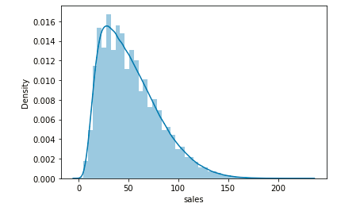
EDA –Sales Data Distribution Trend
Graph shows the Sales column is positively left skewed with median at 47 and maximum at 231.

Slide 5
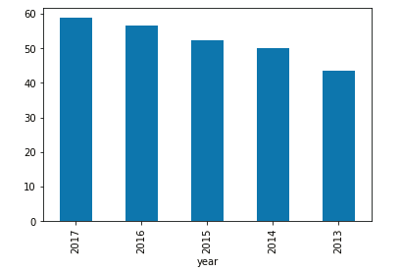
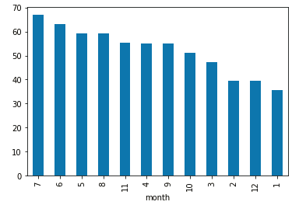
EDA – Yearly and Monthly Sales Trend
Bar chart depicts sales are good in almost every Year and month but predominantly sales are highest in July month of 2017.

Slide 6
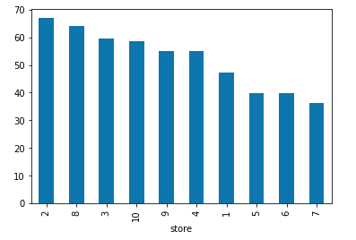
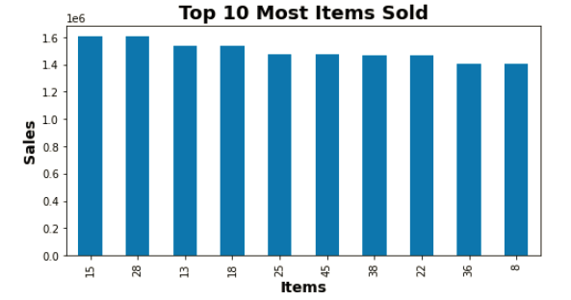
EDA – Most Items sold & Store with highest sales
Store No.2 recorded highest sales
Item No 15 and 28 has recorded good sales.

Slide 7
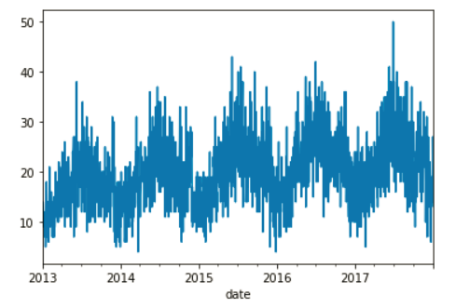
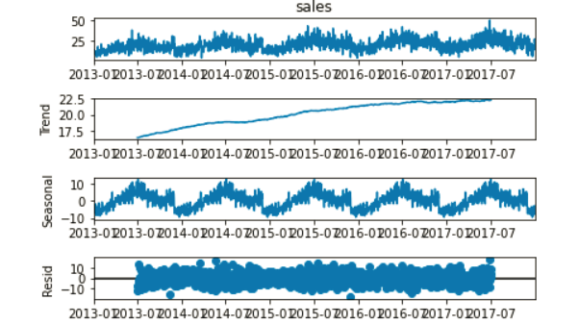
Time Series Analysis - Decomposition
Graph shows the Trend component in the data.
Graph shows the decomposed dataset by observed, trend, seasonal and residual component in the data.

Slide 8
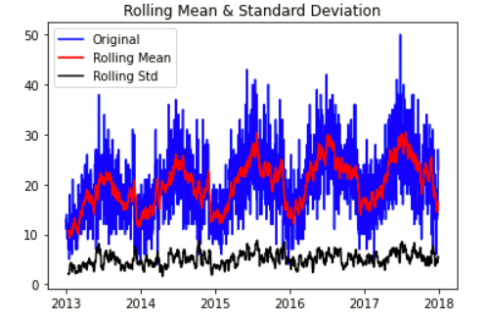
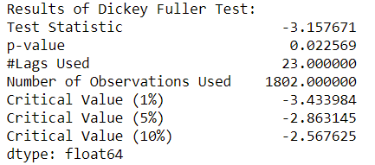
Stationarity check using Rolling statistics and ADF test
Rolling mean has a trend component
Rolling standard deviation is fairly constant with time.
The Dickey-Fuller test the time series is not considered stationary as Test Statistic greater than 1% Critical Value and we can see visually that there is an upwards trend.

Slide 9
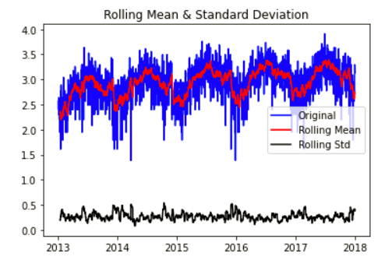
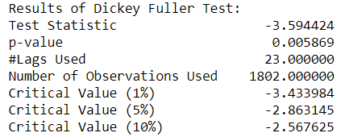
Data Transformation to achieve Stationarity
1) LOG SCALE TRANSFORMATION
Graph shows that even though rolling mean is not stationary, it is still better than the previous case, where no transformation were applied to series. So we can at least say that we are heading in the right direction

Slide 10
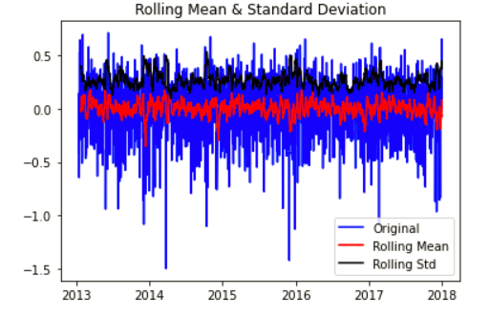
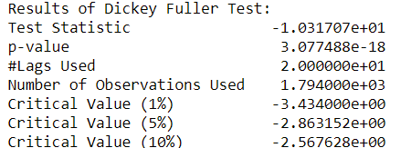
Data Transformation to achieve Stationarity
2) LOG SCALE MINUS MOVING AVERAGE
Graph shows that our intuition that subtracting two related series having similar trend components will make the result stationary is true
Looks like data is somewhat stationary

Slide 11
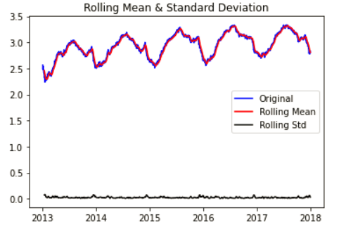
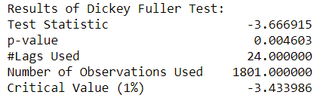
Data Transformation to achieve Stationarity
3) EXPONENTIAL DECAY
Graph shows that exponential decay is not holding any advantage over log scale as both the corresponding curves are similar.
p-value has decreased and Test Statistic value is very much closer to the Critical values. Both the points say that our current transformation is better than the previous logarithmic transformation. Even though, we couldn't observe any differences by visually looking at the graphs, the tests confirmed decay to be much better.

Slide 12
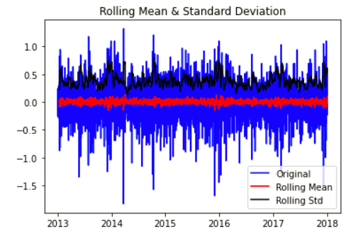
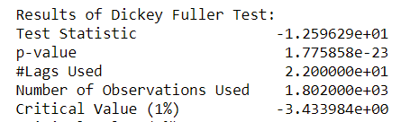
Data Transformation to achieve Stationarity
4) LOG SCALE SHIFTING
Graph shows that, visually this is the best result as our series along with rolling statistic values of moving avg & moving std. dev. is very much flat & stationary.
p-value is extremely small.
Thus this series is very likely to be stationary

Slide 13
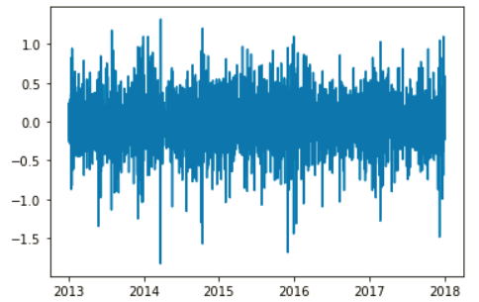
DATA IS NOW STATIONARY
From graph, we can see that, visually this is the best result as our series along with rolling statistic values of moving avg & moving std. dev. is very much flat & stationary.
Test Statistic value not as close to the critical values as that for exponential decay.
We have thus tried out 4 different transformation: log, moving avg, exp decay & time shift. We will go ahead with the time shifted dataset.

Slide 14
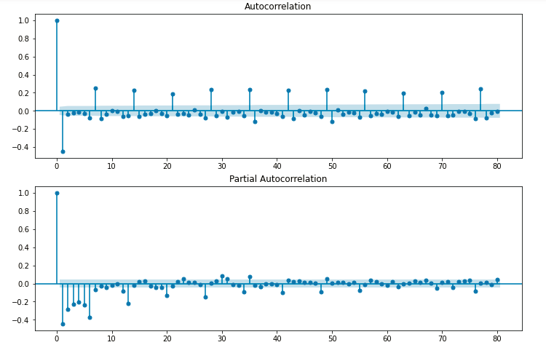
PLOTTING ACF & PACF
Here we can see the ACF and PACF both has a recurring pattern every 7 periods. Indicating a weekly pattern exists. With both P & Q=7

Slide 15
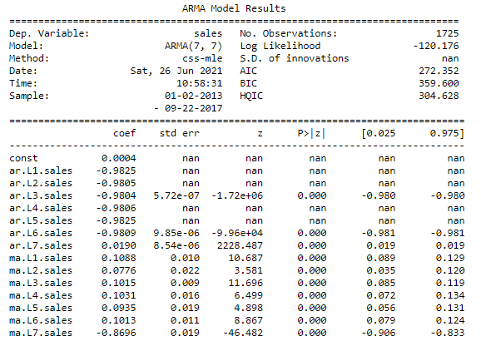
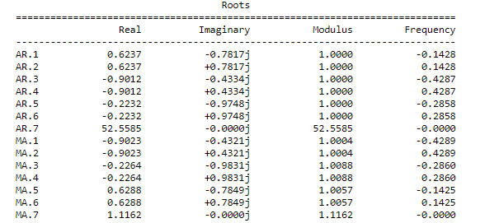
TRAIN TEST SPLIT & BUILDING ARIMA MODEL
Summary of ARMA Model:
Forecasting using the developed model and printing out the 07 month forecast.

Slide 16
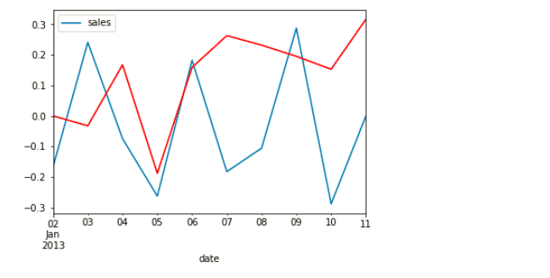
TRAIN THE MODEL
Test MSE: 0.066
Observing the plot of expected vs. the predicted.
The forecast does look pretty good with slightly large deviation.

Slide 17
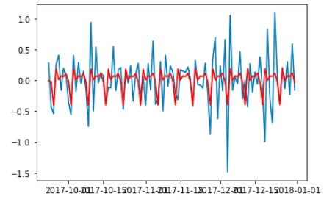
TEST THE MODEL
Test MSE: 0.134
We see that our predicted forecasts are very close to the real time series values indicating a fairly accurate model.

Slide 18
CONCLUSION:
We have built a model to forecast the demand of item 01 sales in a Store 01 Using ARIMA model with p value 07.
Since we observed the ACF and PACF both has a recurring pattern every 07 period which indicates that a weekly pattern exists.

Slide 19
THANK YOU !!

